Slide 1
Logical Agents
AIMA Chapter 7

Slide 2
Outline
Knowledge-based agents
Wumpus world
Logic in general - models and entailment
Propositional (Boolean) logic
Equivalence, validity, satisfiability
Inference rules and theorem proving
forward chaining
backward chaining
resolution

Slide 3

Knowledge Base
Knowledge base = set of sentences in a formal language
Declarative approach to building an agent:
Tell it what it needs to know
Ask itself what to do - answers should follow from the KB
Agents can be viewed at the knowledge level
i.e., what they know, regardless of how implemented
Agents at the implementation level
i.e., data structures in KB and algorithms that manipulate them

Slide 4
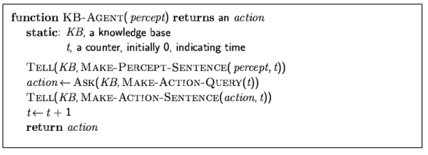
A simple knowledge-based agent
The agent must be able to:
Represent states, actions, etc.
Incorporate new percepts
Update internal representations of the world
Deduce hidden properties of the world
Deduce appropriate actions

Slide 5
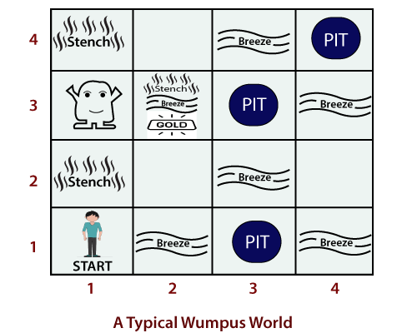
Wumpus World PEAS description
Performance measure
gold +1000, death -1000
-1 per step, -10 for using the arrow
Environment
Squares adjacent (not dialonal) to wumpus are smelly
Squares adjacent to pit are breezy
Glitter if gold is in the same square
Shooting kills wumpus if you are facing it
Shooting uses the only one arrow
Grabbing picks up gold if in same square
Releasing drops the gold in same square
Each square other than the start can be a pit with a probability 0.2
Sensors: [Stench, Breeze, Glitter, Bump, Scream]
Actuators: Left turn, Right turn, Forward, Grab, Release, Shoot

Slide 6
Wumpus world characterization
Fully Observable? No – only local perception
Deterministic? Yes – outcomes exactly specified
Episodic? No – sequential at the level of actions
Static ? Yes – Wumpus and Pits do not move
Discrete? Yes
Single-agent? Yes

Slide 7
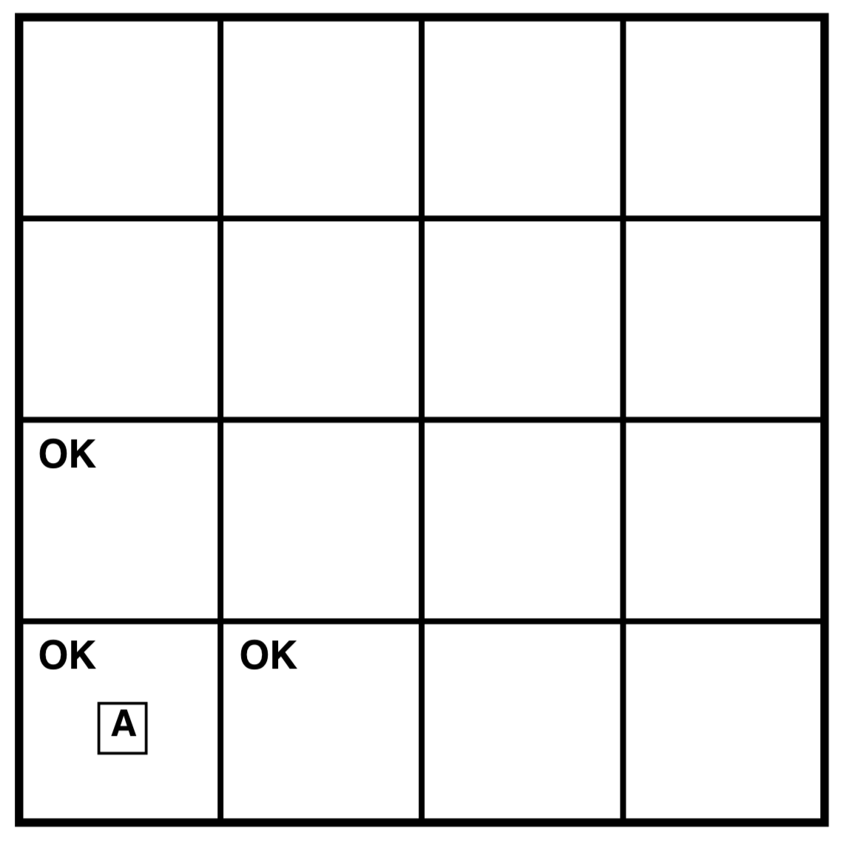
Exploring a wumpus world
Percept: [Stench, Breeze, Glitter, Bump, Scream]
[None, None, None, None, None]
A cautious agent will move only into a square that it knows is OK
The agent’s state of knowledge at this point

Slide 8
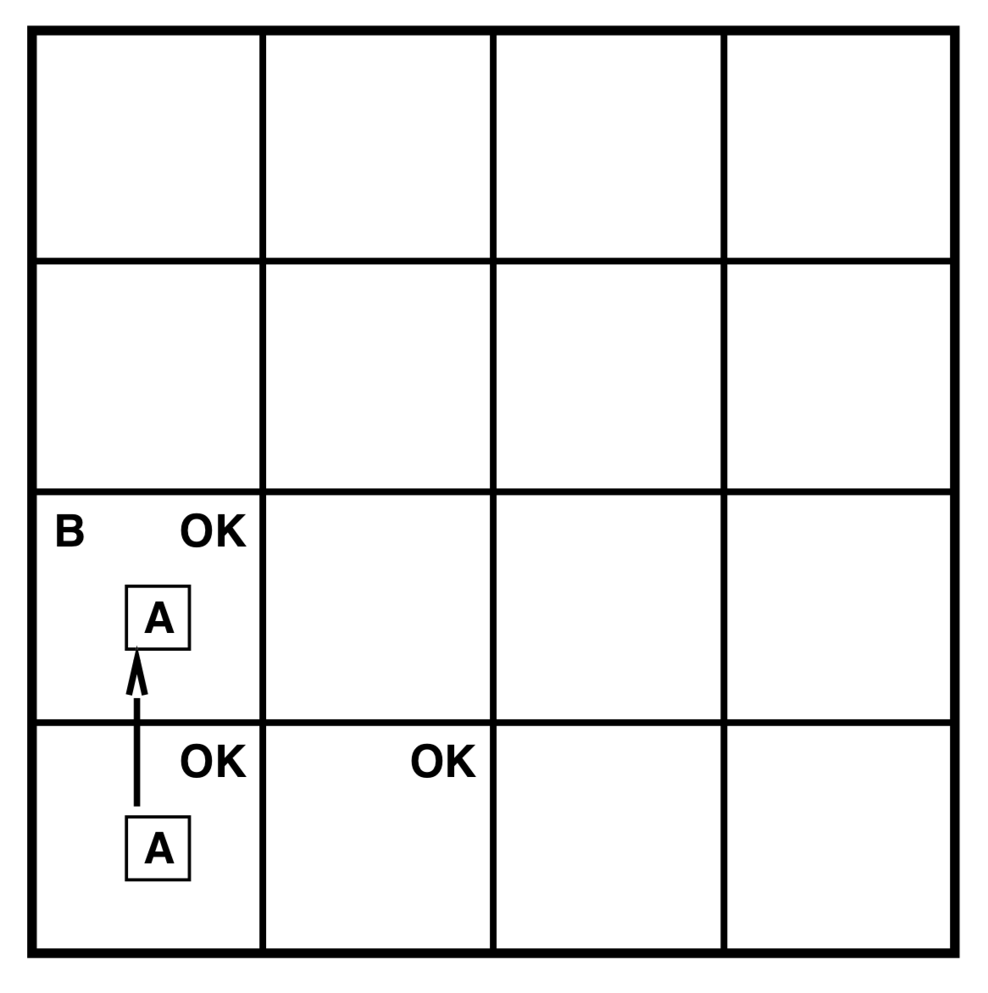
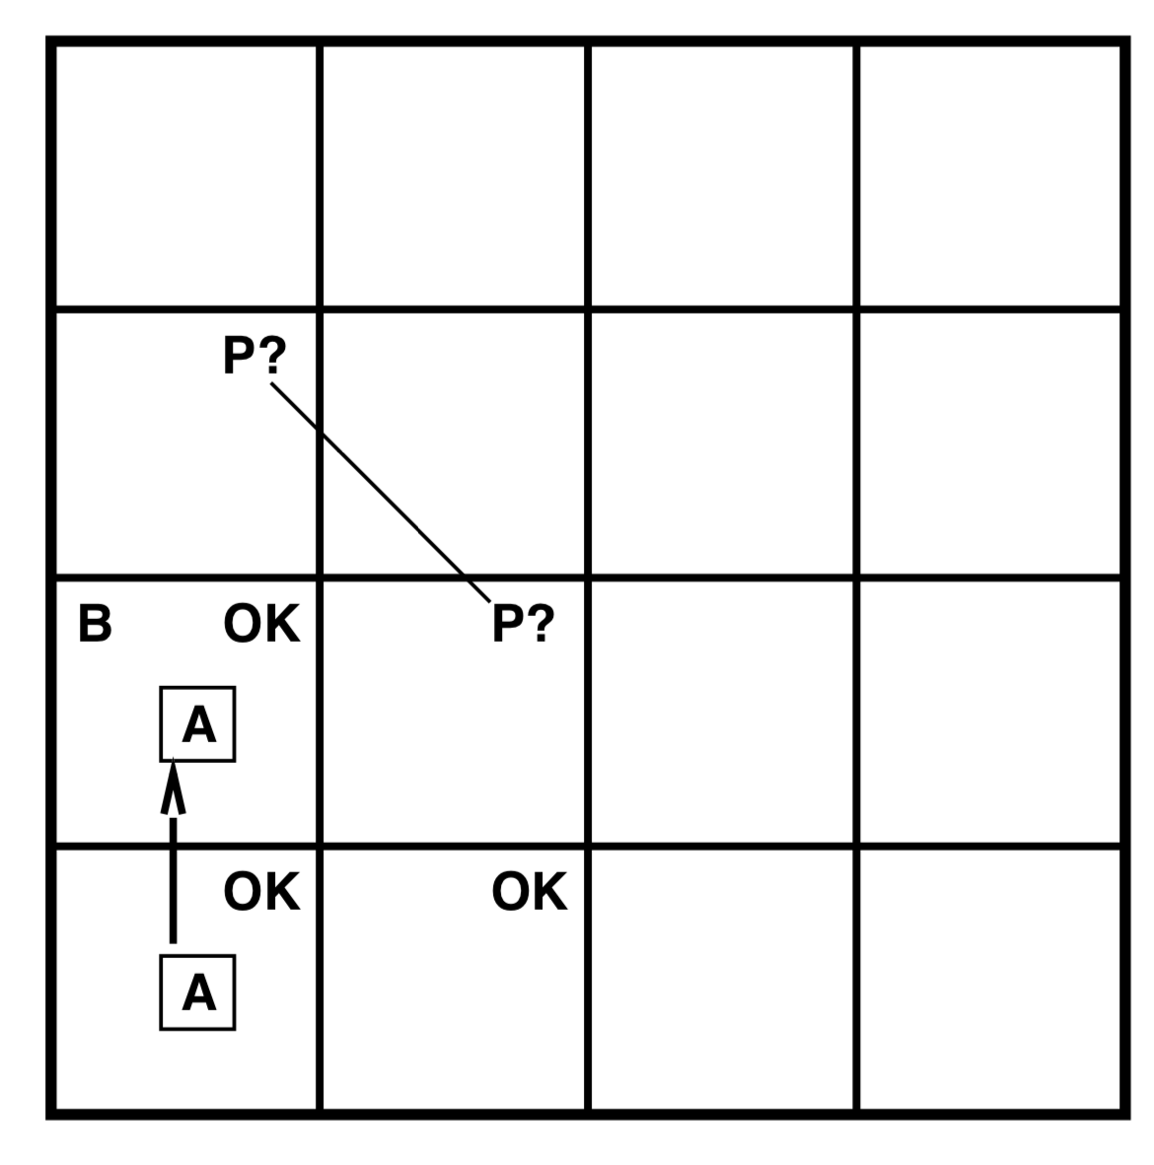
Exploring a wumpus world
Pit
Breeze

Slide 9
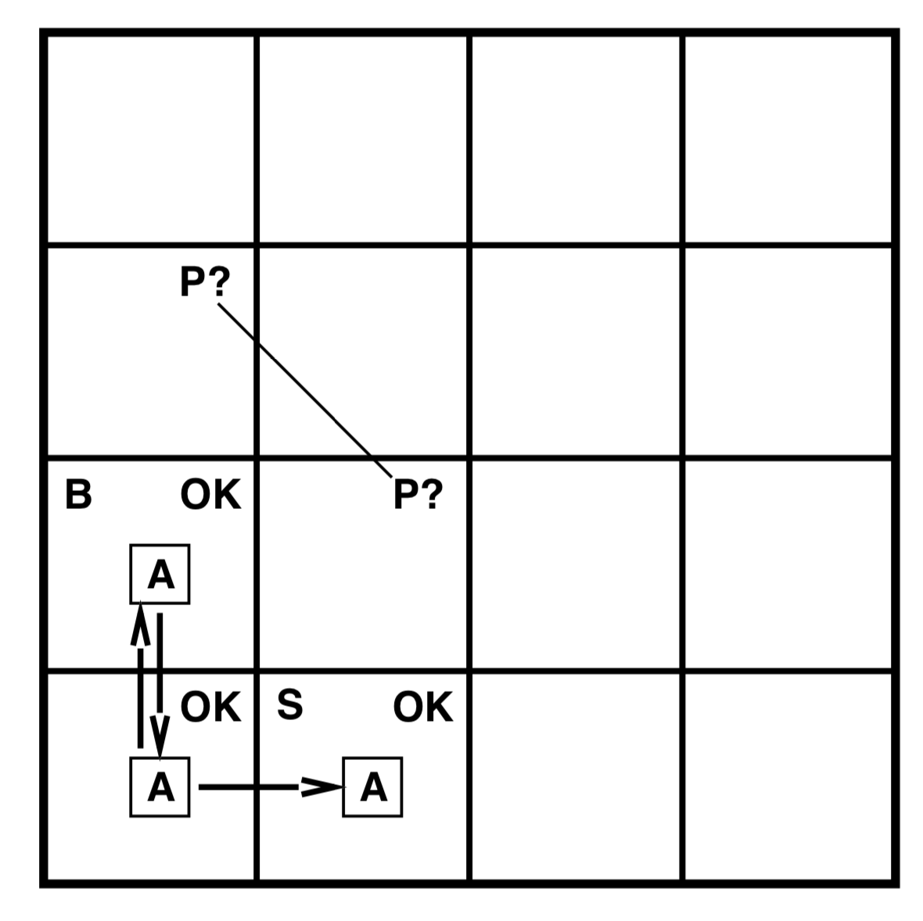
Exploring a wumpus world
A cautious agent will move only into a square that it knows is OK
Stench

Slide 10
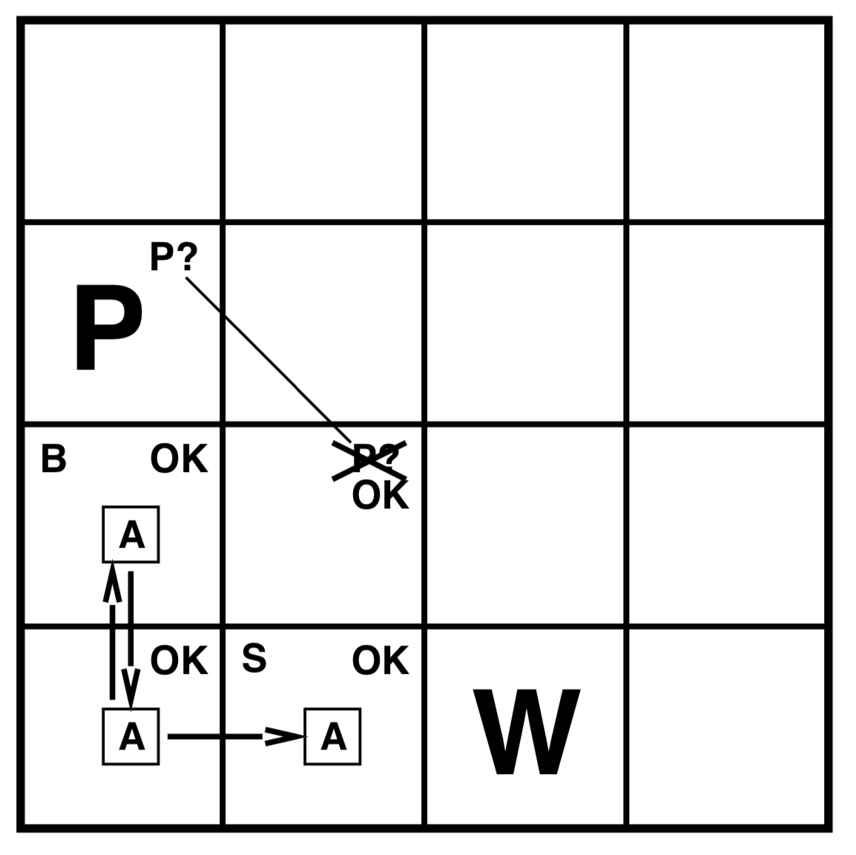
Exploring a wumpus world
Percept: [Stench, Breeze, Glitter, Bump, Scream]
[Stench, None, None, None, None]
Agent draws a conclusion that there is a wumpus in [3,1] and pit in [1,3]
Difficult inference because it combines knowledge gained at different times in different locations and relies on the lack of a percept
Wumpus

Slide 11
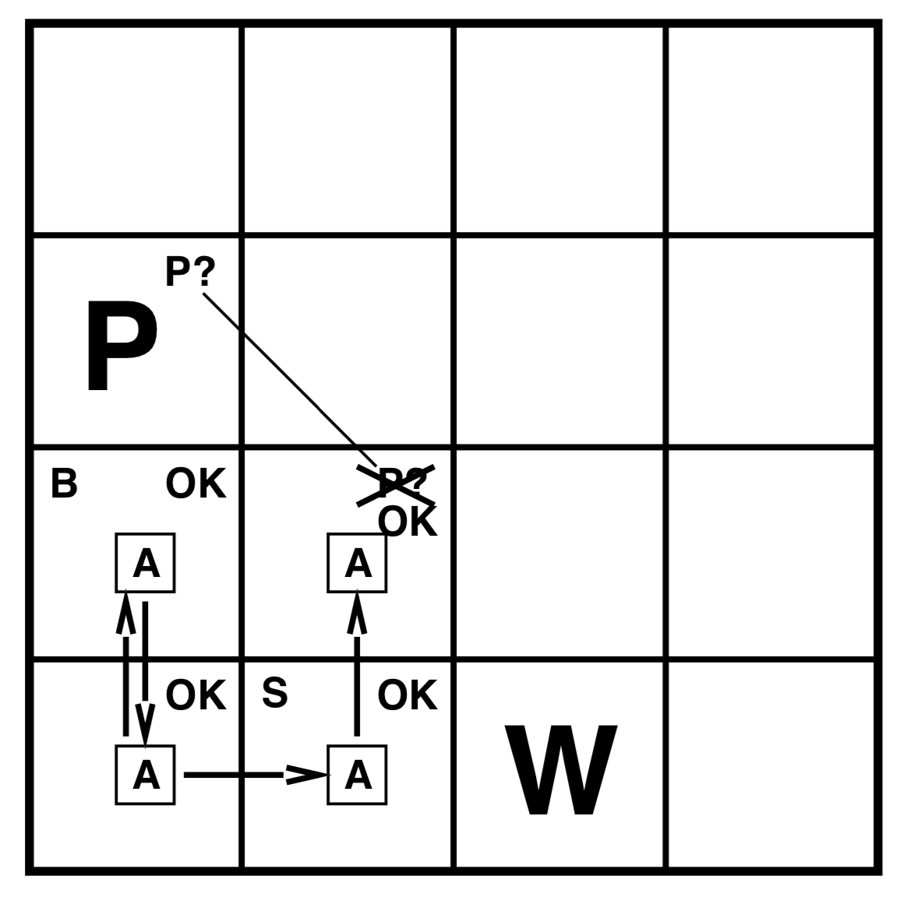
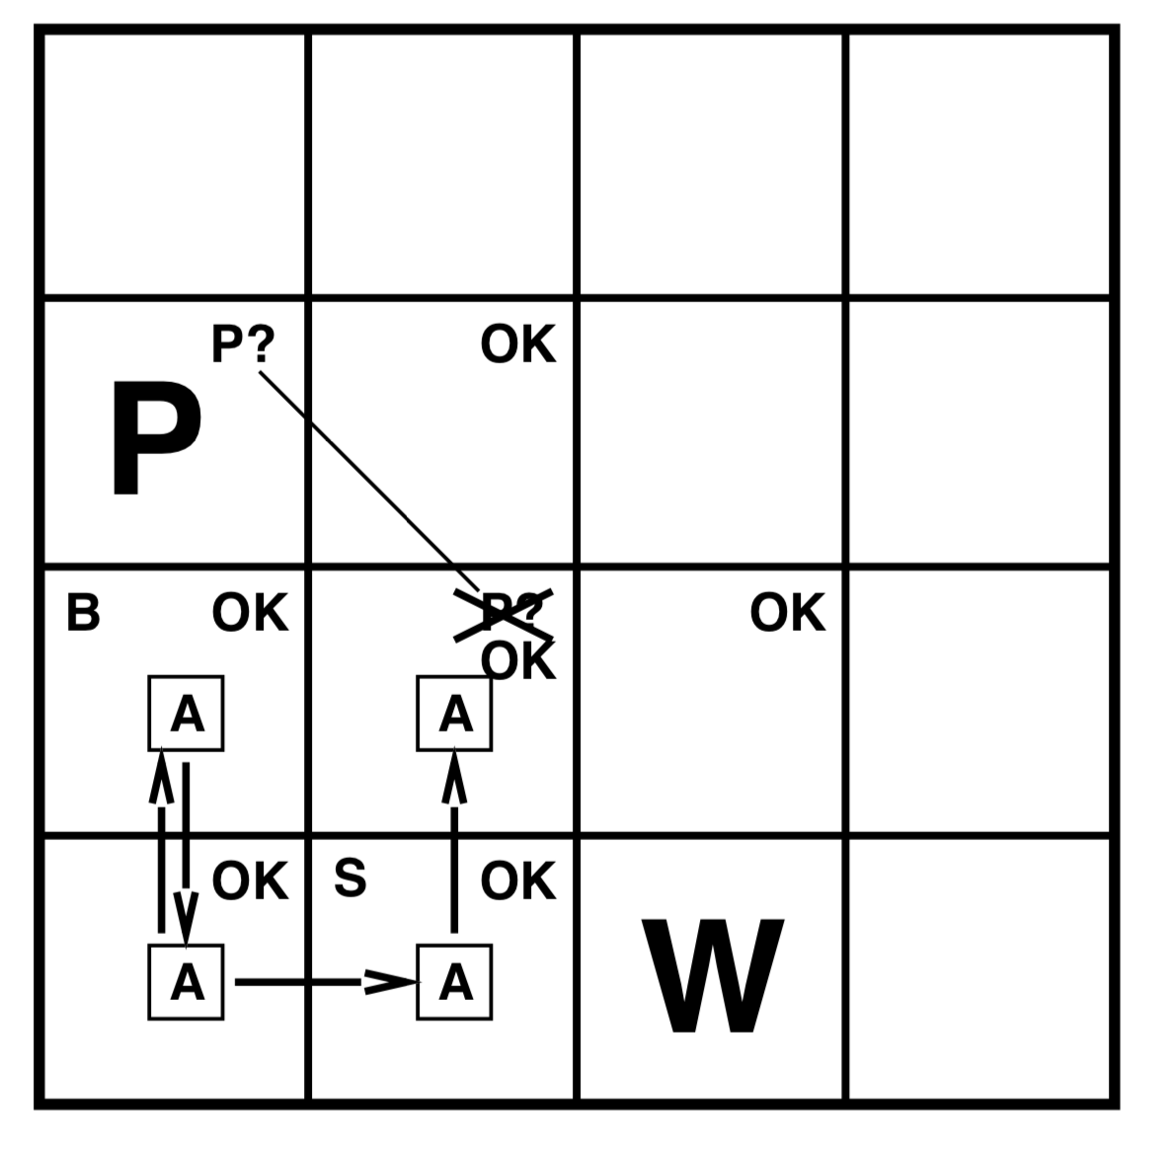
Exploring a wumpus world

Slide 12
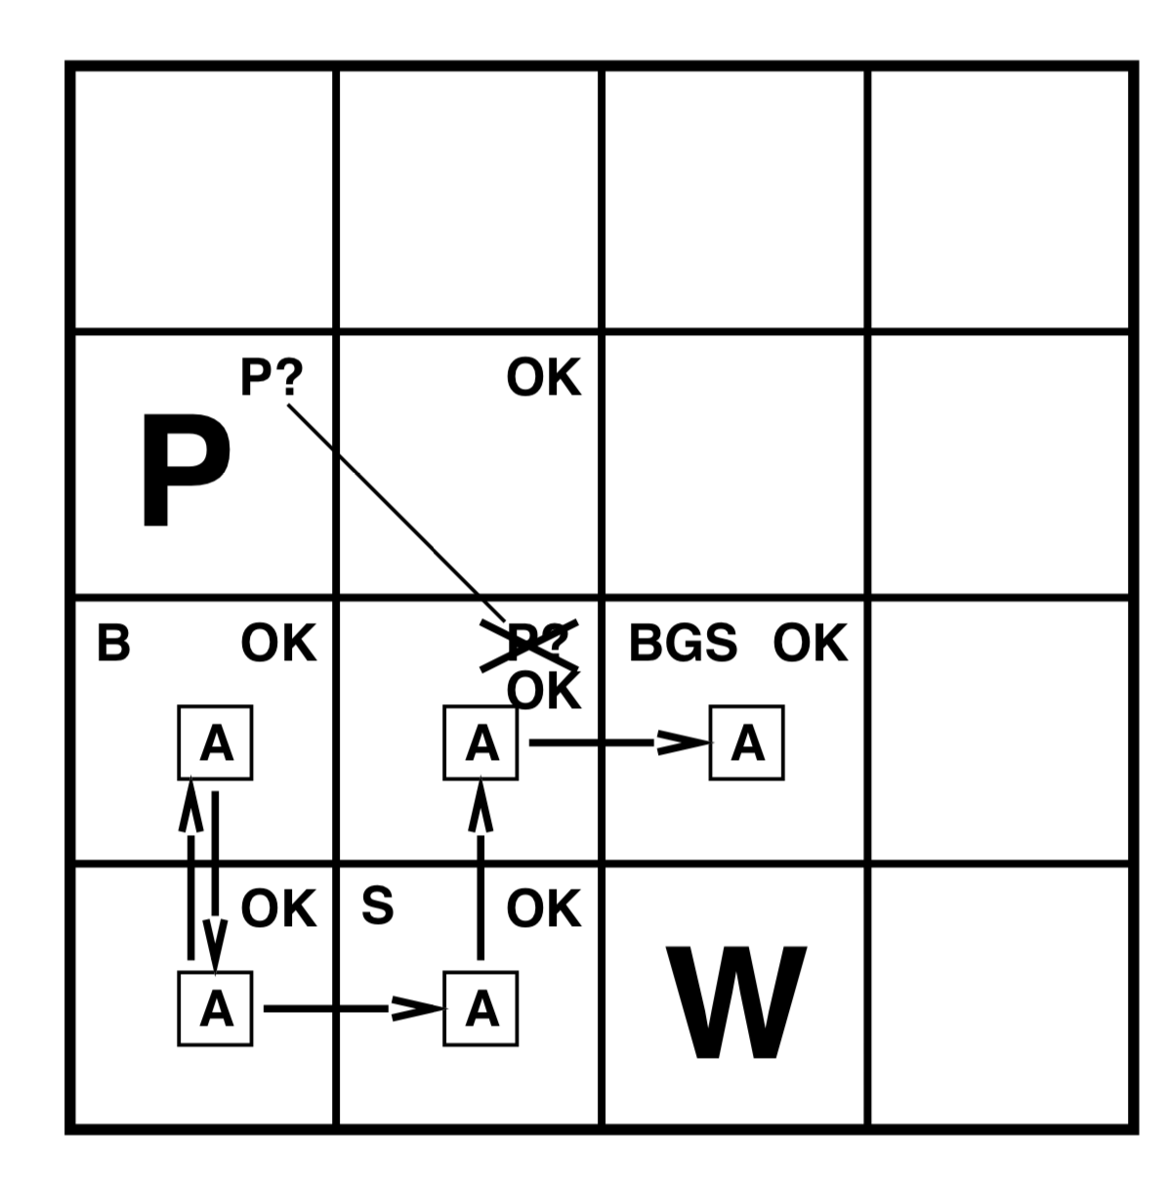
Exploring a wumpus world
Percept: [Stench, Breeze, Glitter, Bump, Scream]
[Stench, Breeze, Glitter, None, None]
Agent draws a conclusion that there is a gold in [3,2] and grabs it

Slide 13
We will learn
how to build logical agents that can represent the necessary information and draw the conclusions

Slide 14
Logic in general
Logics are formal languages for representing information such that conclusions can be drawn
Syntax defines the sentences in the language
x+2 ≥ y is a sentence; x2+y >= is not a sentence
Semantics define the "meaning" of sentences; truth of a sentence in a world
x+2 ≥ y is true iff the number x+2 is no less than the number y
x+2 ≥ y is true in a world where x = 7, y = 1
x+2 ≥ y is false in a world where x = 0, y = 6

Slide 15
Reasoning: Entailment
Entailment means that one sentence follows logically from another sentence:
KB ╞ α
Knowledge base KB entails sentence α if and only if α is true in all worlds where KB is true
E.g., the KB containing “the Giants won” and “the Reds won” entails “Either the Giants won or the Reds won”
E.g., x+y = 4 entails 4 = x+y
Entailment is a relationship between sentences that is based on semantics
E.g., Where x means the number of men and y means the number of women sitting on a bench, x + y = 4 is true only when there are four in total

Slide 16
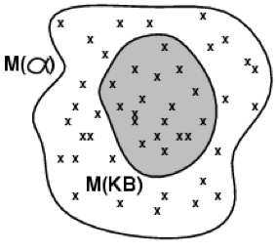
Models
Models are possible worlds with respect to which truth can be evaluated
m is a model of a sentence α if α is true in m
M(α) is the set of all models of α
Then KB ╞ α iff M(KB) ⊆ M(α)
E.g. KB = Giants won and Reds won
α = Giants won

Slide 17
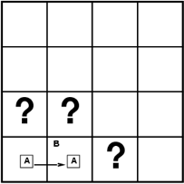
Entailment in the wumpus world
Situation after detecting nothing in [1,1], moving right, breeze in [2,1]
Consider possible models for KB when the agent is interested in whether adjacents squares contain pits
3 Boolean choices => 8 possible models

Slide 18
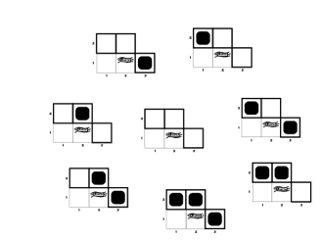
Wumpus models

Slide 19
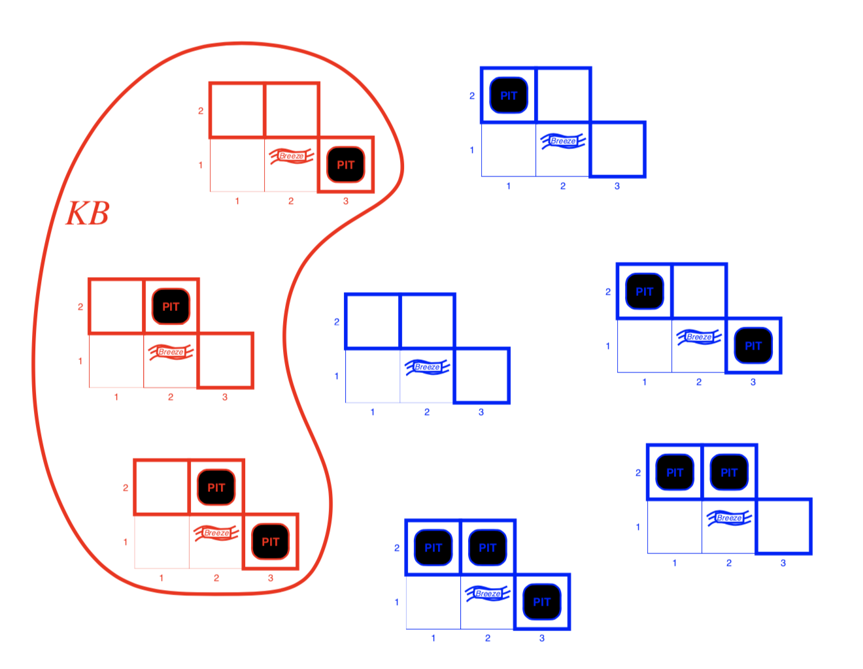
Wumpus models
KB = wumpus-world rules + observations

Slide 20
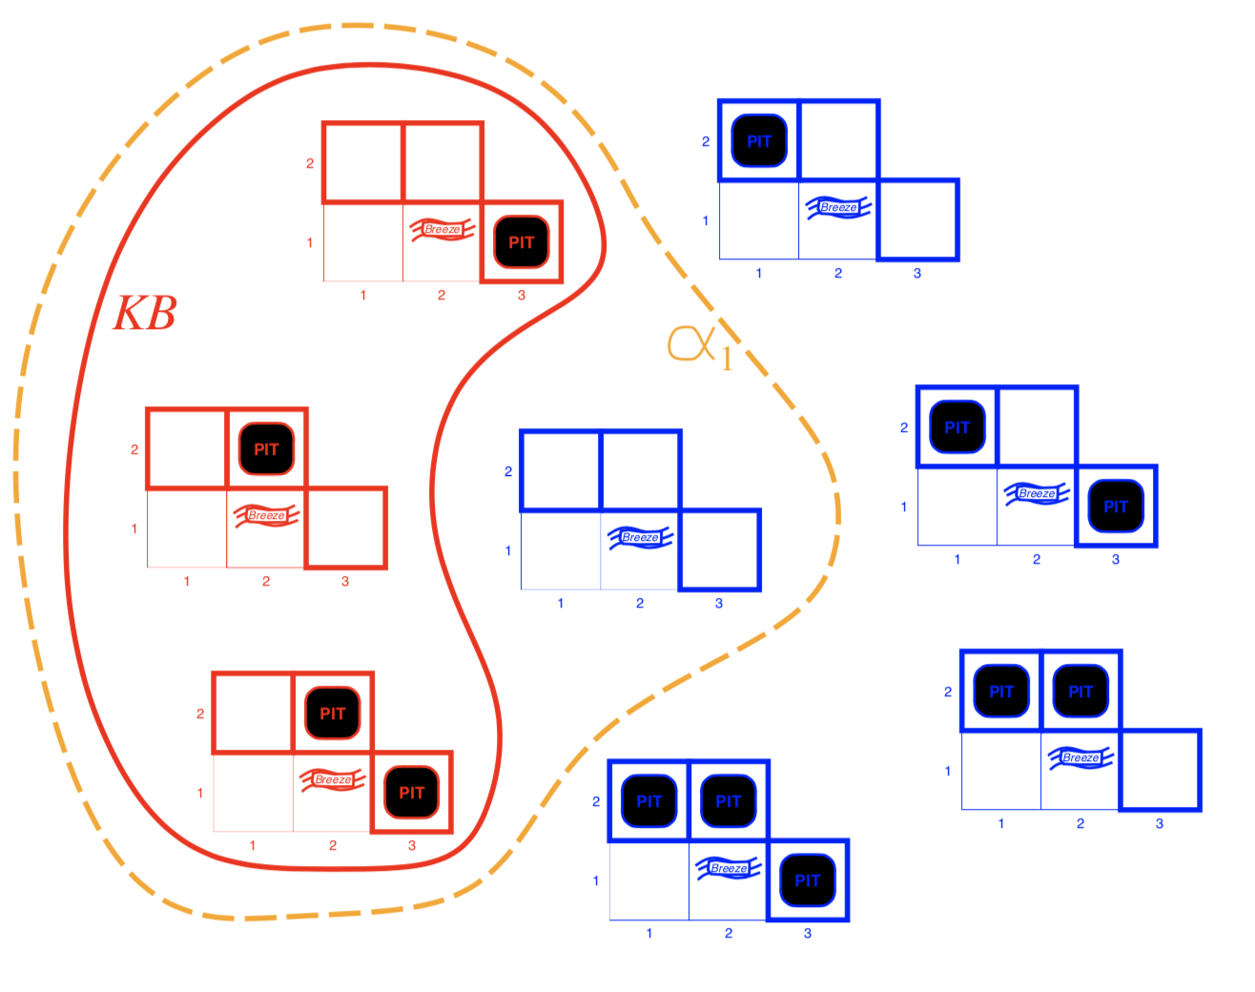
Wumpus models
KB = wumpus-world rules + observations
Conclusion α1 = "[1,2] is safe",
In every model in which KB is true, α1 is also true
KB ╞ α1, proved by model checking

Slide 21
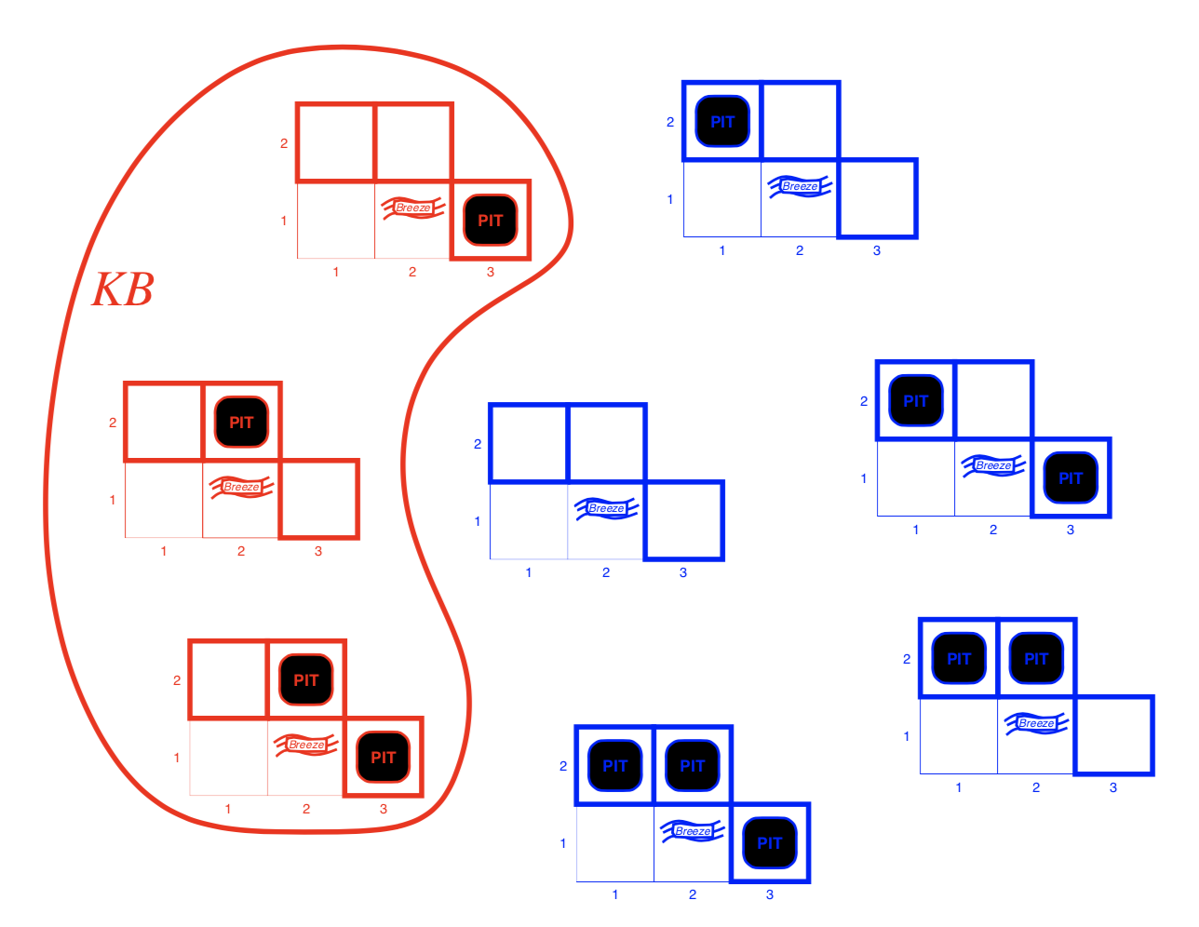
Wumpus models
KB = wumpus-world rules + observations

Slide 22
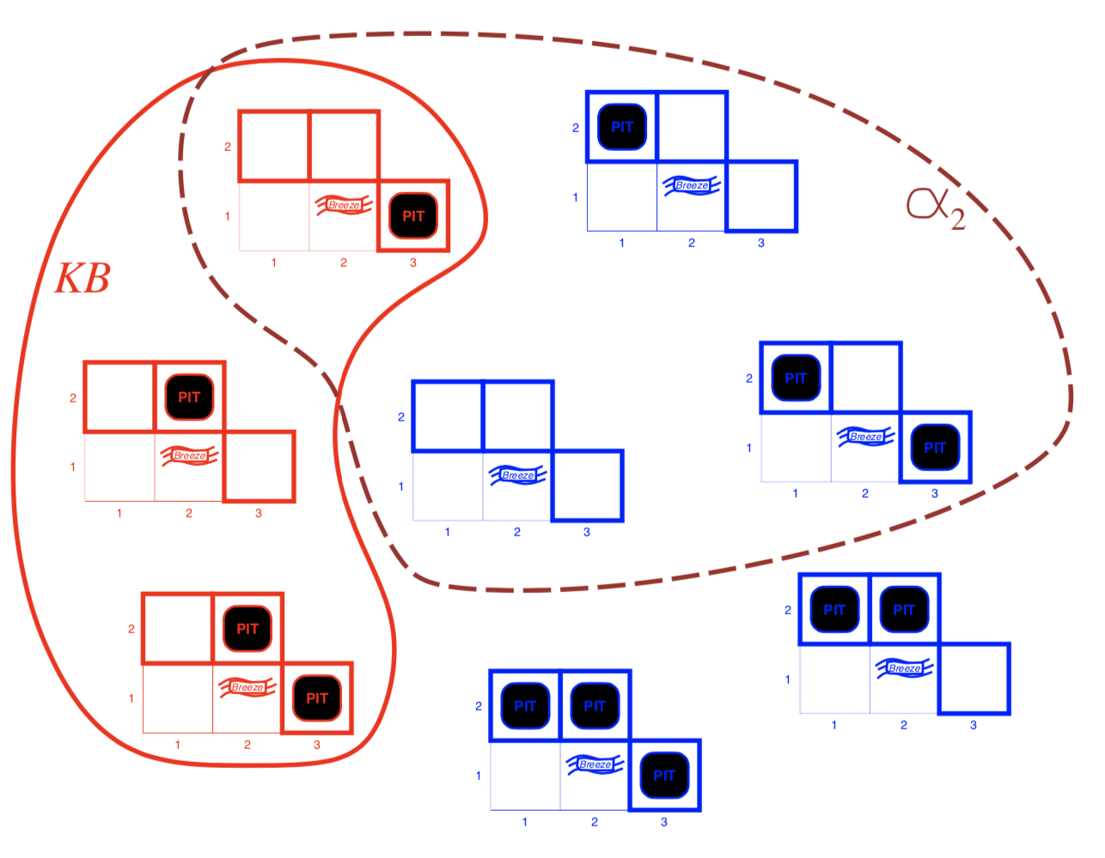
Wumpus models
KB = wumpus-world rules + observations
Conclusion α2 = "[2,2] is safe"
In some models in which KB is true, α2 is false
KB ⊭α2

Slide 23
Inference
KB├i α: α can be derived from KB by inference algorithm i, or i derives α from KB
Soundness: i is sound if whenever KB ├i α, it is also true that KB╞ α
Completeness: i is complete if whenever KB╞ α, it is also true that KB ├i α; i.e., it can derive any sentence that is entailed
We now present a simple logic called propositional logic and will define a logic (first-order logic) which is expressive enough to say almost anything of interest, and for which there exists a sound and complete inference procedure
That is, the procedure will answer any question whose answer follows from what is known by the KB

Slide 24
Propositional Logic
Propositional logic is the simplest logic – illustrates basic ideas
Proposition is a statement that can be defined as a declarative sentence, or part of a sentence, that is capable of having a truth-value, such as being true or false. So, for example, the following are statements:
George W. Bush is the 43rd President of the United States.
Paris is the capital of France.
Everyone born on Monday has purple hair.

Slide 25
Propositional logic: Syntax
Atomic sentence: consists of a single proposition symbol. e.g., P, Q, R
Each symbol stands for a proposition that an be true or false
Two symbols with fixed meaning: True is always-true proposition and False is always-false proposition
Complex sentences are constructed from simpler sentences using logical connectives

Slide 26
Propositional logic: Connectives
If S is a sentence, ￢S is a sentence (negation)
Literal is either an atomic sentence (a positive literal) or a negated atomic sentence (a negative literal)
If S1 and S2 are sentences, S1 ⋀ S2 is a sentence (conjunction, and)
If S1 and S2 are sentences, S1 ⋁ S2 is a sentence (disjunction, or)
If S1 and S2 are sentences, S1 ⟹ S2 is a sentence (implication, rule, if-then statement)
S1: premise or antecedent, S2: conclusion or consequent
If S1 and S2 are sentences, S1 ⟺ S2 is a sentence (biconditional, if and only if)

Slide 27
Sentence Examples
학생이 시험에서 90점을 맞는다
학생이 시험에서 90점을 맞지 않는다
A학점을 받는다
학생이 시험에서 90점을 맞고 A학점을 받는다
학생이 시험에서 90점을 맞거나 A학점을 받는다
학생이 시험에서 90점을 맞으면 A학점을 받는다

Slide 28
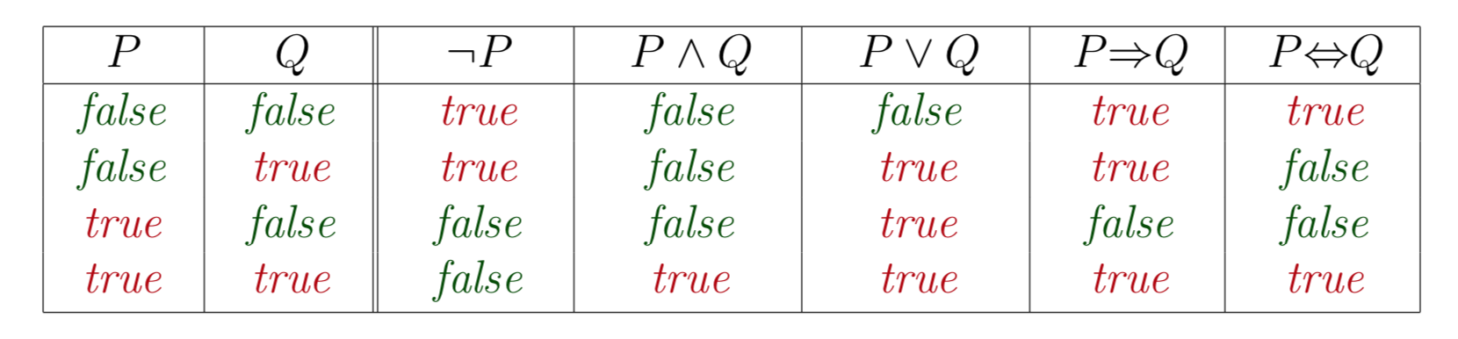
Truth tables for connectives

Slide 29
Propositional logic: Semantics
With 3 symbols, 8 possible models can be enumerated automatically
E.g. P_{1,2} P_{2,2} P_{3,1}
Each model specifies true/false for each proposition symbol
E.g. m₁ = { P_{1,2} = false, P_{2,2} = false, P_{3,1} = true}

Slide 30
Propositional logic: Semantics
Rules for evaluating truth
￢S is true iff S is false
S1 ⋀ S2 is true iff S1 is true and S2 is true
S1 ⋁ S2 is true iff S1 is true or S2 is true
S1 ⟹ S2 is true iff S1 is false or S2 is true
i.e., S1 ⟹ S2 is false iff S1 is true and S2 is false
S1 ⟺ S2 is true iff S1⟺S2 is true and S2⟺S1 is true
Simple recursive process evaluates an arbitrary sentence, e.g.,
￢P_{1,2} ⋀ (P_{2,2} ⋁ P_{3,1}) = true ⋀ (false ⋁ true) = true ⋀ true = true

Slide 31
Wumpus world sentences
Let P_{i,j} be true if there is a pit in [i, j]
Let B_{i,j} be true if there is a breeze in [i, j]
There is no pit in [1,1]: ￢P_{1,1}
There is a breeze in [1,1]: B_{1,1}
There is a breeze in [2,1]: B_{2,1}
"Pits cause breezes in adjacent squares"
B_{1,1} ⟺ (P_{1,2} ⋁ P_{2,1})
B_{2,1} ⟺ (P_{1,1} ⋁ P_{2,2} ⋁ P_{3,1})

Slide 32
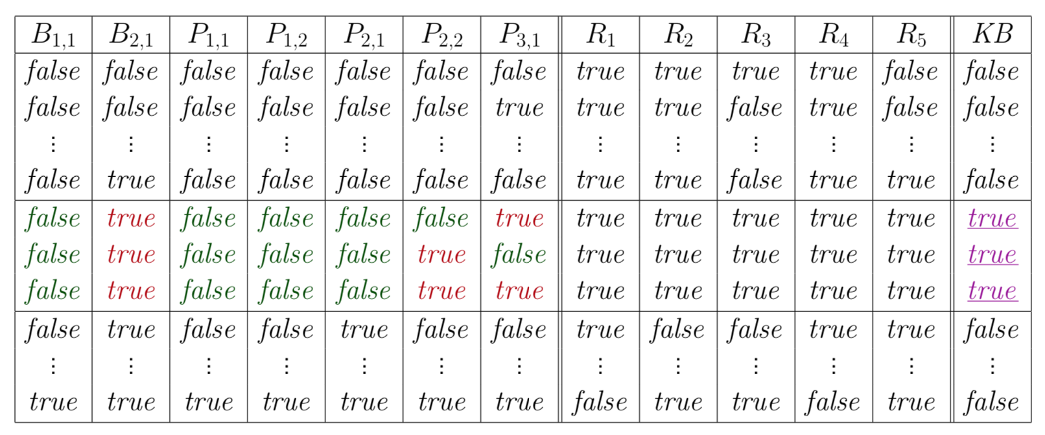
Truth tables for inference
Enumerate rows (different assignments to symbols), if KB is true in row, check that α is too

Slide 33
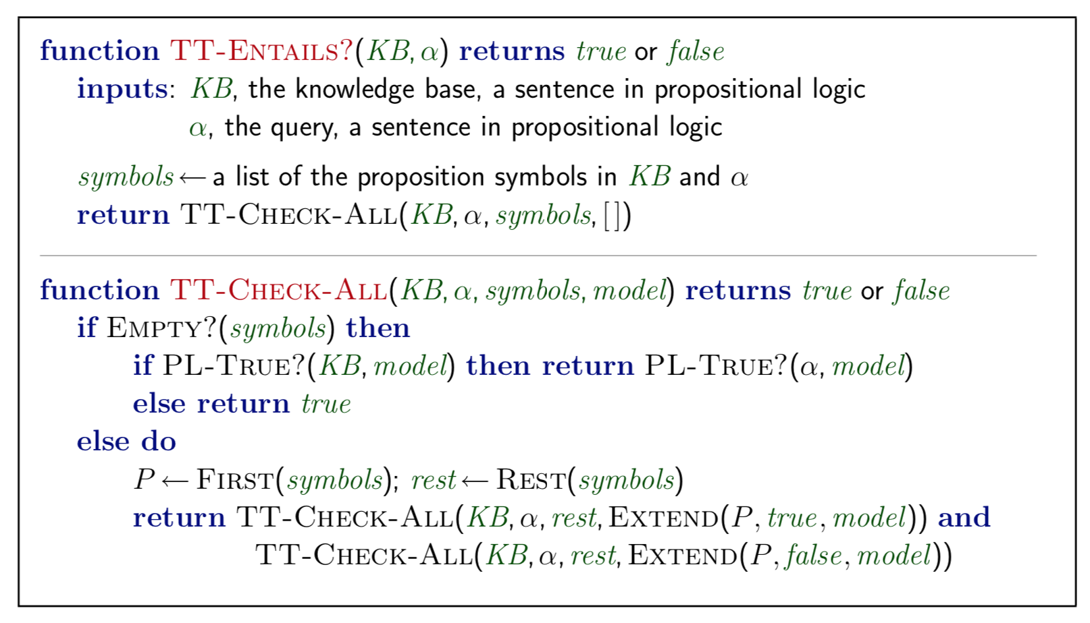
Inference by enumeration
A truth-table enumeration algorithm for deciding propositional entailment
Depth-first enumeration of all models is sound and complete
For n symbols, time complexity is O(2^{n}), space complexity is O(n)

Slide 34
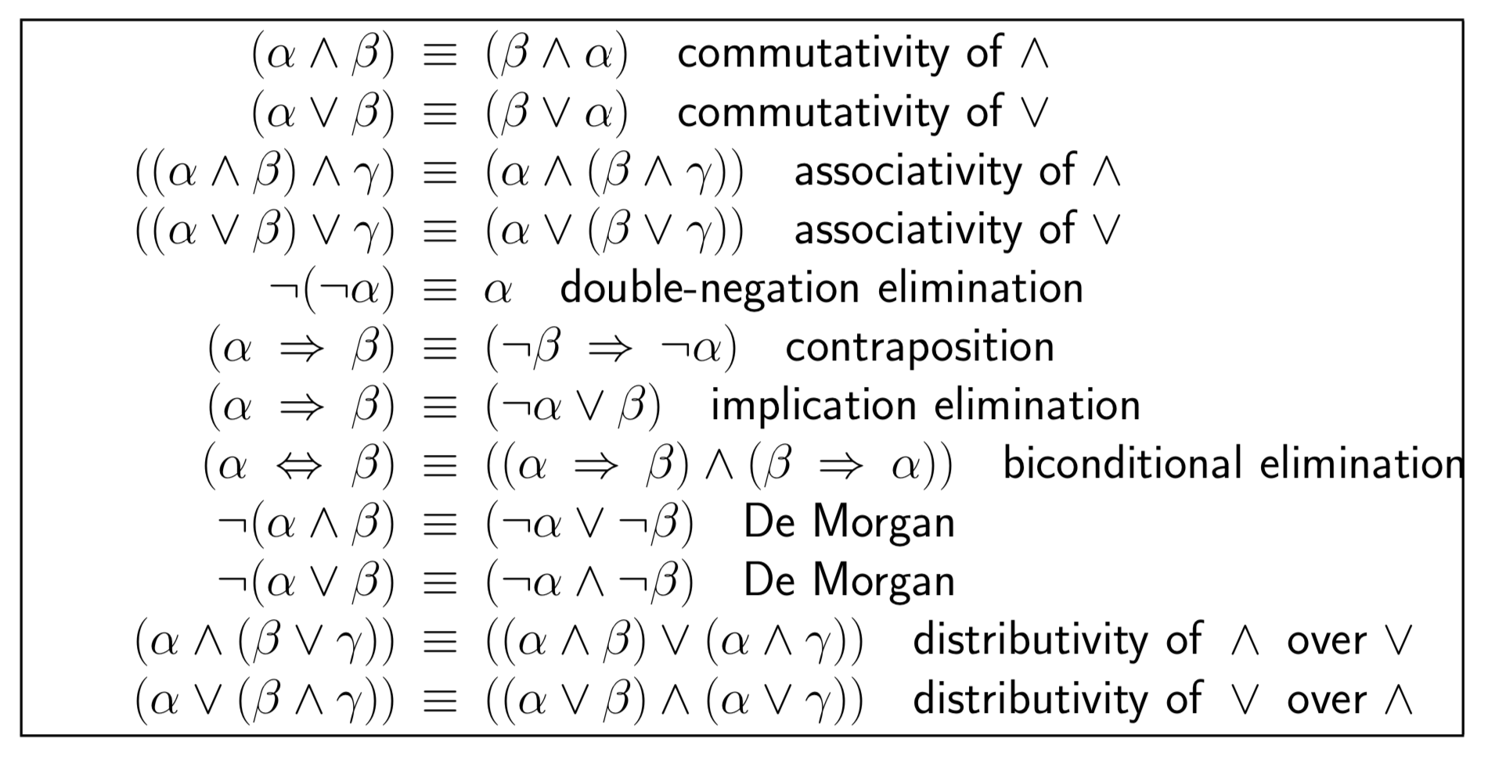
Logical equivalence
α and ß are logically equivalent iff true in same models: α ≡ ß iff α╞ β and β╞ α

Slide 35
Validity and satisfiability
A sentence is valid if it is true in all models,
e.g., True, ￢A⋁ A, A ⟹ A, (A ⋀ (A ⟹ B)) ⟹ B
Validity is connected to inference via the Deduction Theorem:
KB ╞ α if and only if (KB ⟹ α) is valid
A sentence is satisfiable if it is true in some model
e.g., A ⋁ B, C
A sentence is unsatisfiable if it is true in no models
e.g., ￢A ⋀ A
Satisfiability is connected to inference via the following:
KB ╞ α if and only if (KB ⋀ ￢α) is unsatisfiable
i.e., prove α by contradiction or reductio ad absurdum (reduction to an absurd thing)

Slide 36
Proof methods
Proof methods divide into (roughly) two kinds:
Application of inference rules
Legitimate (sound) generation of new sentences from old
Proof = a sequence of inference rule applications
Can use inference rules as operators in a standard search algorithm
Typically require transformation of sentences into a normal form
Model checking
Truth table enumeration (always exponential in n)
Improved backtracking, e.g., Davis--Putnam-Logemann-Loveland (DPLL)
Heuristic search in model space (sound but incomplete)
e.g., min-conflicts-like hill-climbing algorithms

Slide 37
Inference Rules
Apply inference rules to derive a proof - a chain of conclusions that leads to the desired goal
Modus Ponens (Latin for mode that affirms, if-then reasoning)
And-Elimination
antecedent, premise
𝛂 ⟹ 𝛃, 𝛂
𝛃
consequent, conclusion
𝛂 ⋀ 𝛃
𝛂

Slide 38
Inference Rules
Apply inference rules to derive a proof - a chain of conclusions that leads to the desired goal
Modus Ponens (Latin for mode that affirms, if-then reasoning)
And-Elimination
antecedent, premise
𝛂 ⟹ 𝛃, 𝛂
𝛃
WumpusAhead ⟹ Shoot, WumpusAhead
Shoot
consequent, conclusion
𝛂 ⋀ 𝛃
𝛂
WumpusAhead ⋀ WumpusAlive
WumpusAlive

Slide 39
Application of Modus-Ponens for Inference/Proof
Forward chaining
As facts are added to the knowledge base, modus ponens is used to fire all applicable implication rules
These new propositions can be used to fire implication rules applicable to them
The process continues until no further facts can be deduced
Backward chaining
First, the query formula is true if it is present in the knowledge base
If not present, search for applicable implication rules present in the knowledge base. An applicable rule is one where the consequent of the rule matches the query formula
If there are any such rules, then the query can be proved if the antecedent of any one them are true
This can be performed recursively by backward chaining on the antecedent as a new query.

Slide 40
Wumpus world sentences
There is no pit in [1,1]
R1: ￢P_{1,1}
"Pits cause breezes in adjacent squares"
R2: B_{1,1} ⟺ (P_{1,2} ⋁ P_{2,1})
R3: B_{2,1} ⟺ (P_{1,1} ⋁ P_{2,2} ⋁ P_{3,1})
B_{i,j} is true if there is a breeze in [i, j]
R4: ￢B_{1,1}
R5: B_{2,1}
Prove ￢P1,2

Slide 41
Prove by applications of inference rules
Knowledge Base
R1: ￢P1,1
R2: B_{1,1} ⟺ (P_{1,2} ⋁ P_{2,1})
R3: B_{2,1} ⟺ (P_{1,1} ⋁ P_{2,2} ⋁ P_{3,1})
Percept R4: ￢B_{1,1}
Percept R5: B_{2,1}
Apply biconditional elimination to R2:
R6: (B1,1 ⟹(P1,2 ⋁ P2,1)) ⋀ ((P1,2 ⋁ P2,1) ⟹B1,1)
Appy And-Elimination to R6:
R7: (P1,2 ⋁ P2,1) ⟹ B1,1)
Apply logical equivalence for contrapositives
R8: (￢B1,1 ⟹ ￢(P1,2 ⋁ P2,1))

Slide 42
Prove by applications of inference rules
Knowledge Base
R1: ￢P1,1
R2: B_{1,1} ⟺ (P_{1,2} ⋁ P_{2,1})
R3: B_{2,1} ⟺ (P_{1,1} ⋁ P_{2,2} ⋁ P_{3,1})
Percept R4: ￢B_{1,1}
Percept R5: B_{2,1}
Apply logical equivalence for contrapositives
R8: (￢B1,1 ⟹ ￢(P1,2 ⋁ P2,1))
Apply Modus Ponens with R8 and the percept R4:
R9: ￢(P1,2 ⋁ P2,1)
Apply De Morgan to R9: R10: ￢P1,2 ⋀ ￢P2,1

Slide 43
Apply search algorithms to find proof
Define a proof problem
Initial state: the initial knowledge base
Actions: set of actions consisting of the inference rules
Result: the result of applying the matched inference rules
Goal: a state that contains the sentence we try to prove
In many practical cases finding a proof can be more efficient than enumerating models because the proof can ignore irrelevant propositions, no matter how many of them there are

Slide 44
Proof by contradiction
KB ╞ α if and only if (KB ⋀ ￢α) is unsatisfiable
Prove α by contradiction or reductio ad absurdum (reduction to an absurd thing)

Slide 45
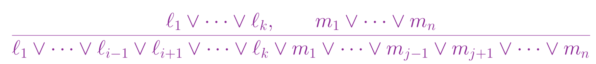
Resolution
Conjunctive Normal Form (CNF):conjunction of disjunctions of literals (=clauses)
E.g., (A ⋁ ￢B) ⋀ (B ⋁ ￢C ⋁ ￢D)
Resolution inference rule (for CNF): complete for propositional logic
where l_{i} and m_{j} are complementary literals.

Slide 46
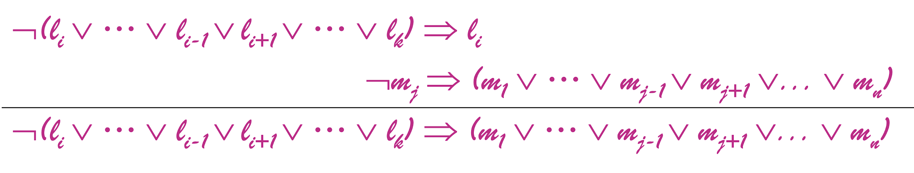

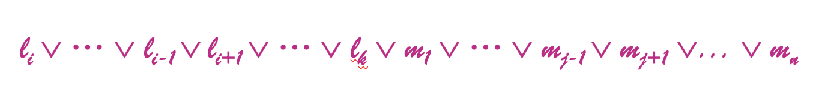
Resolution
Soundness of resolution inference rule:

Slide 47
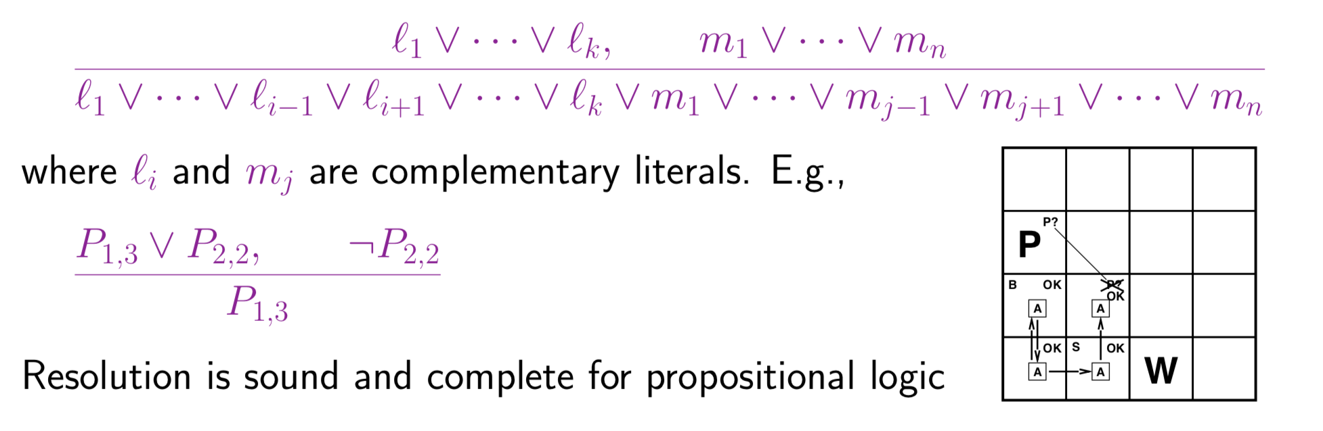
Resolution

Slide 48
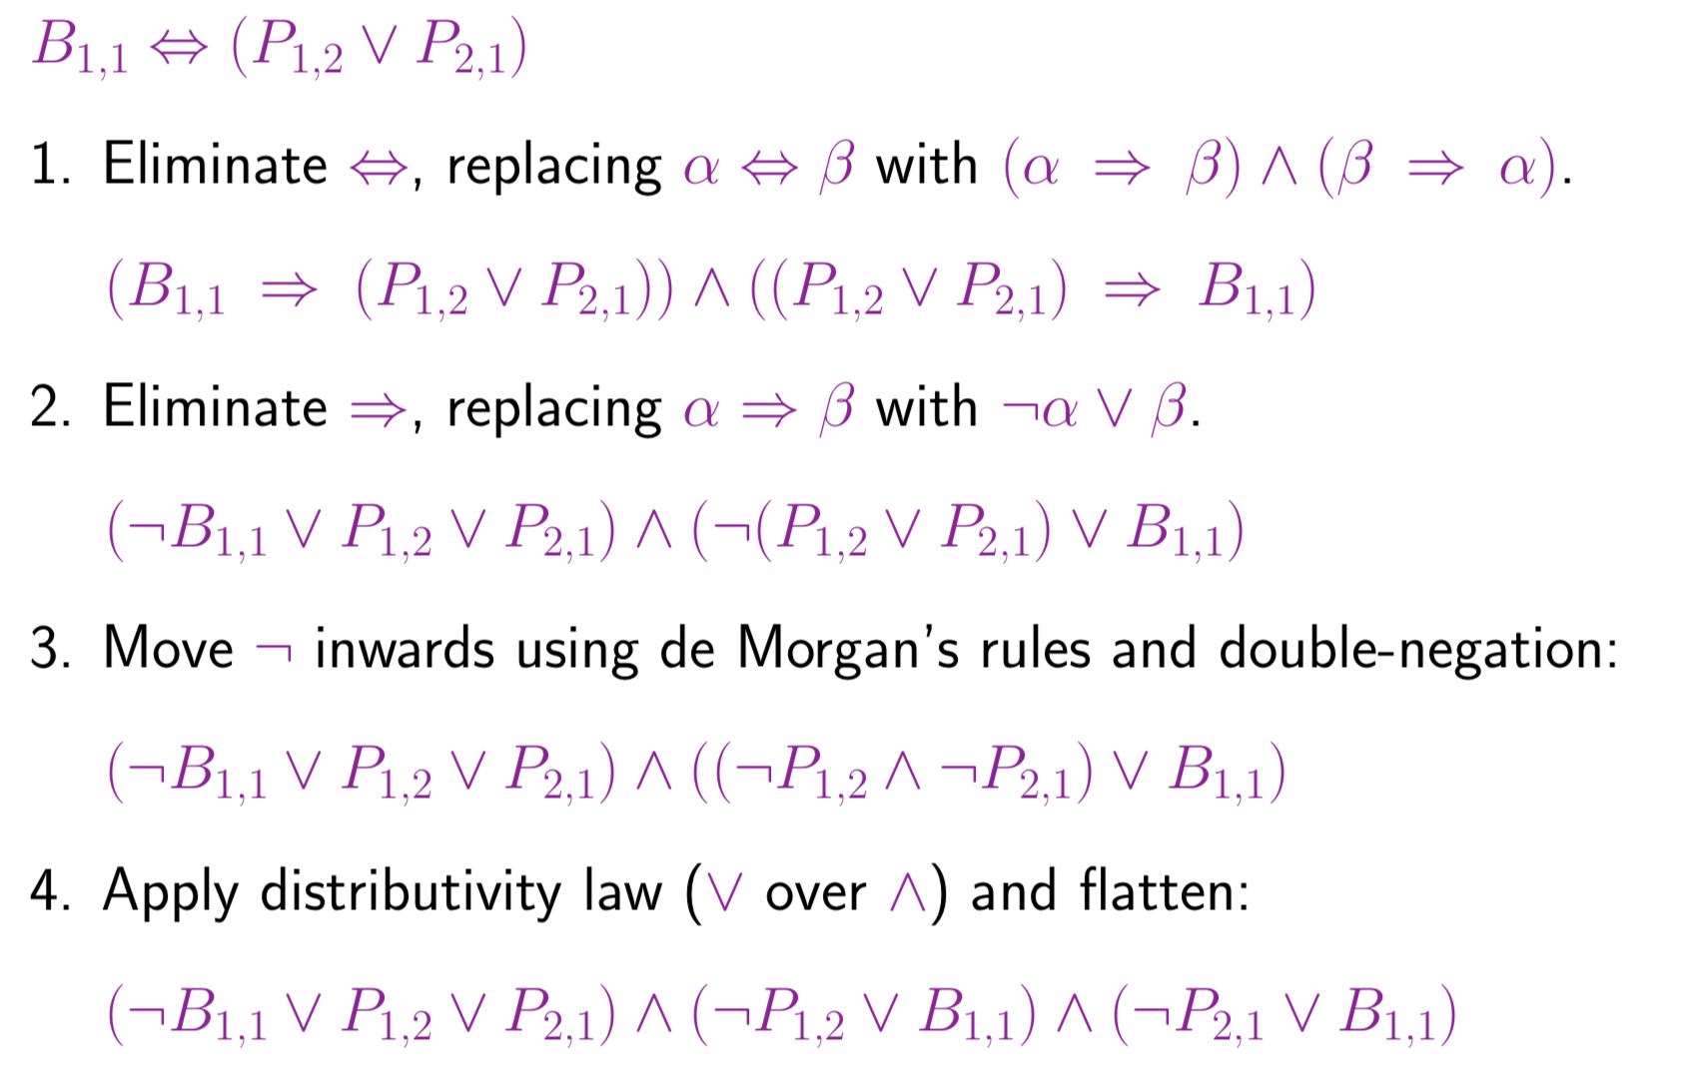
Conversion to CNF

Slide 49
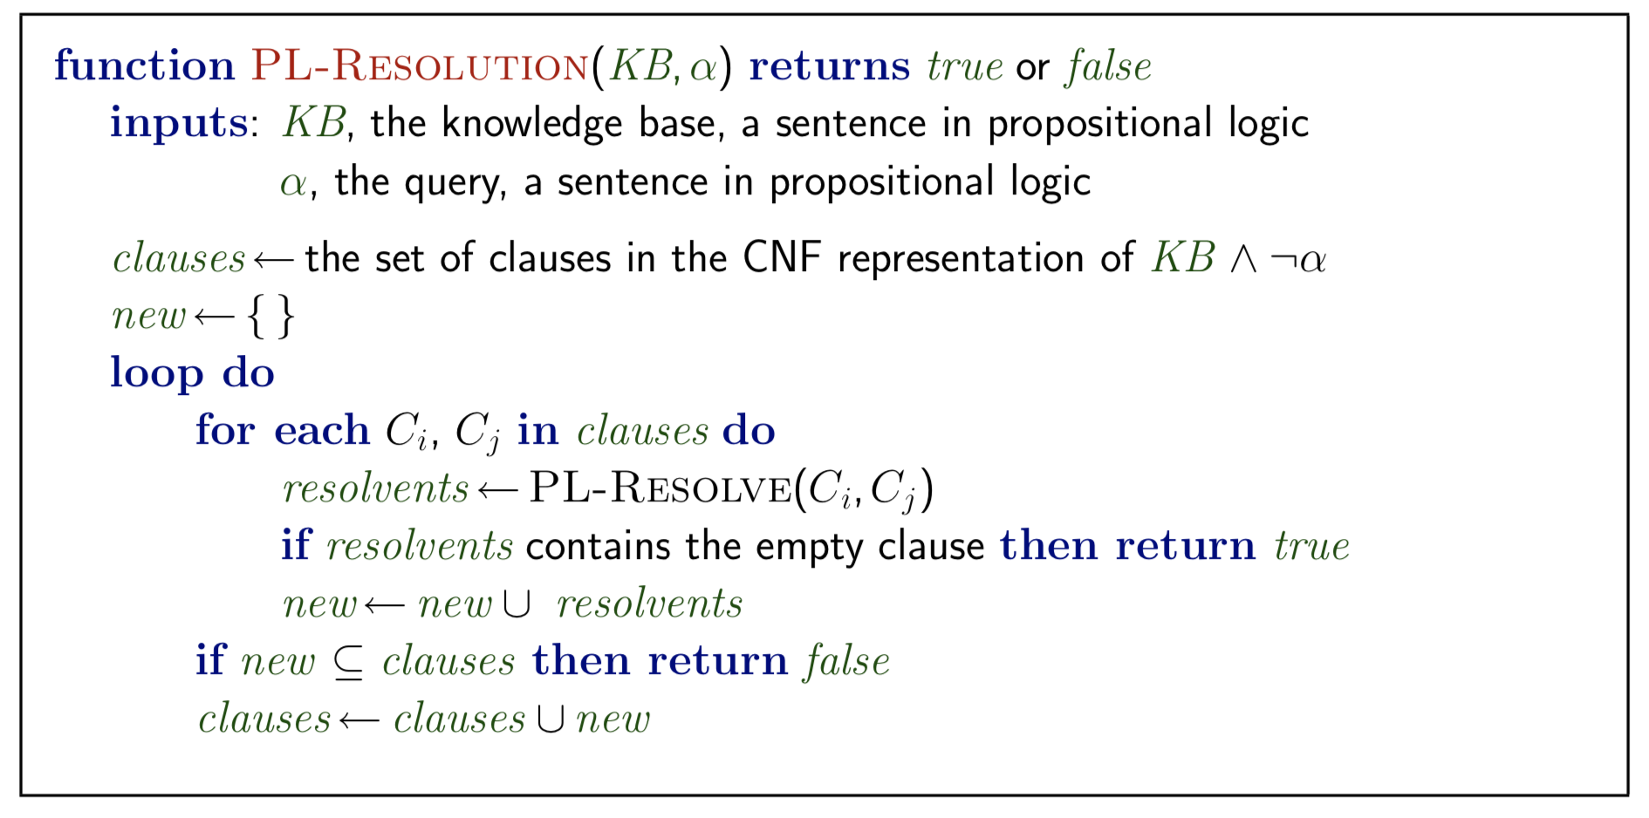
Resolution algorithm
Proof by contradiction, i.e., show KB ∧ ¬α unsatisfiable

Slide 50
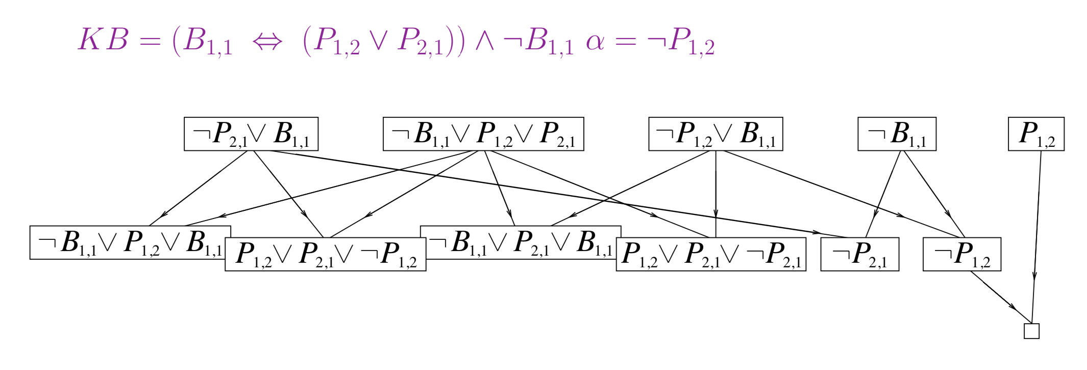
Resolution

Slide 51
Resolution

Slide 53
Summary
Logical agents apply inference to a knowledge base to derive new information and make decisions
Basic concepts of logic:
syntax: formal structure of sentences
semantics: truth of sentences wrt models
entailment: necessary truth of one sentence given another
inference: deriving sentences from other sentences
soundness: derivations produce only entailed sentences
completeness: derivations can produce all entailed sentences
Wumpus world requires the ability to represent partial and negated information, reason by cases, etc.

